Slide 1

Cryptocurrency Pricing Model
Final Class Project
Columbia School of Engineering
Data Analytics and Visualization
July 2021
Collaborators:
Bimla Basnet
Cameron Ewan
Bob Ciminera

Slide 2
Crypto Currency Pricing Project Overview
Problem Statement:
Can crypto currency pricing be predicted with an accuracy >= 75% using machine learning techniques?
Collaborators:
Bimala Basnet
Cameron Ewan
Bob Ciminera

Slide 3
Architecture for Crypto Pricing Model
Market Data
Bob
Database
Bimla
Machine Learning
Ewan
Presentation
Bob
Extract:
Source API’s:
- coingecko.com
- lunarcrush.com
- messari.io.com
Pandas notebooks
Outputs:
market csv
sentiment csv
Transform & Load: ERD
Postgres SQL
Colab notebooks
AWS DB
Outputs:
ERD - Schema
3 Tables AWS DB:
1. coin gecko
2. lunar crush
3. combined 1&2
Combined csv
Supervised ML:
imblearn modules
sklearn modules
RandomForest
Pandas notebooks
Outputs:
Preprocessed data
Trained ML Model
75% Accuracy
Visualization:
Tableau
Outputs:
Dashboard
Story
ML Output
Analysis

Slide 4
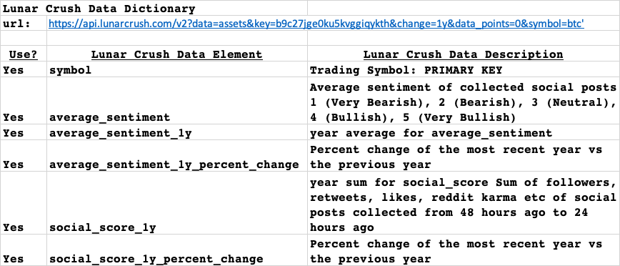
Data Dictionary: Sentiment Data

Slide 5
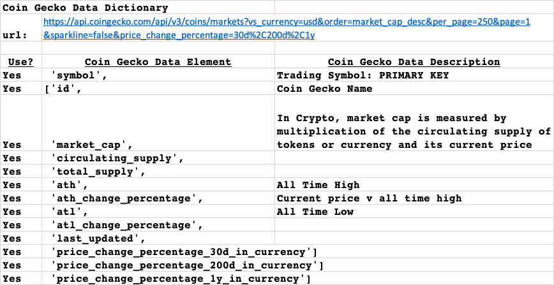
Data Dictionary: Market Data

Slide 6
July 11
July 18
July 25

